Slide 1
What Do Users Want: Enhancing Metadata Using Google Analytics
Jackie Couture
Eastern Kentucky University
Jackie.couture@eku.edu

Slide 2
Who Are We?
Regional Public University
Approximately 16,000 students
3 Full-time Staff
Over 1000 Accessions
300 Processed Collections

Slide 3
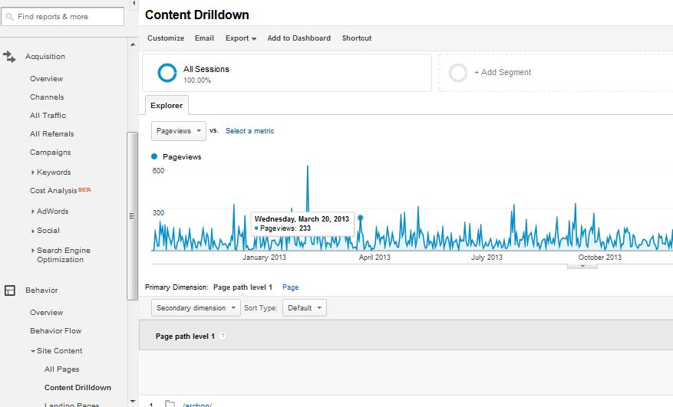
Where Are Search Terms Hiding?
Notes:
650 words

Slide 4
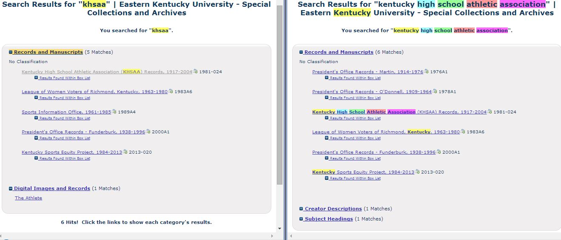
Where Are All the Collections?

Slide 5
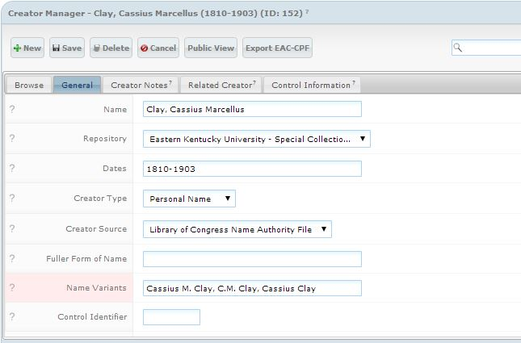
How Many Names Does He Have?

Slide 6
What Do You Call WWI?
WWI
WW1
World War I
World War 1
World War One
World War, 1914-1918

Slide 7
Where Do We Go From Here?
Add organizational acronyms
Continue to Add Name Variants to Creator records
Add Topical Subject Headings

